Slide 1
GOES Status
Matt Seybold, GOES-R Data Ops Manager, PRO Team Lead
Elizabeth Kline, Tom Feroli, Ryan Williams, Randy Race, Steve Superczynski
Joint GRB-HRIT/EMWIN User Group Meeting - March 15, 2023

Slide 2
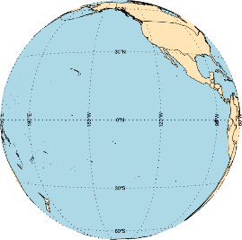
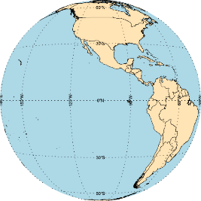

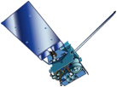

GOES Constellation
GOES-West
GOES-18
137.0°W
Storage
GOES-15
128°W
Co-Standby
GOES-14
108.2°W
Standby
GOES-17
104.7°W
GOES-East
GOES-16
75.2°W
Above diagram locations and constellation roles are effective February 10, 2023
Note the Standby role locations are slightly different from the precedent location of 105°W
Checkout of GOES-17 spacecraft, instrument, and product generation occurred February 10 – March 14, 2023
For a GOES-16/18 (East/West) anomaly, GOES-17 will be activated. If it is a warm season for the GOES-17 ABI loop heat pipe anomaly then GOES-14 will also be activated in series after GOES-17
  Field users leveraging smaller antennas (~5m) will not be able to simultaneously downlink GOES-17 GRB and GOES-14 GVAR due to interference because GRB will dominate the signal
GOES-15 property transfer to U.S. Air Force (USSF) is in progress and drift to USSF location will commence NST April, 2023
Location History for GOES-18 PLT Phase and the Swap of GOES-17/18
03/01-05/15, 2022: GOES-18 PLT Part 1 pre-drift checkout at 89.5°W
05/15-06/06, 2022: GOES-18 drift to 136.8°W
07/05-07/15, 2022: GOES-18 nudge from 136.8°W to 137.0°W, GOES-17 nudge from 137.2°W to 137.3°W
01/10-02/12, 2023: GOES-17 drift to 104.7°W
M. Seybold, D. Pogorzala

Slide 3
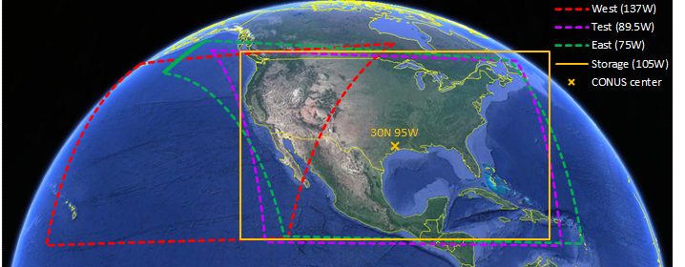
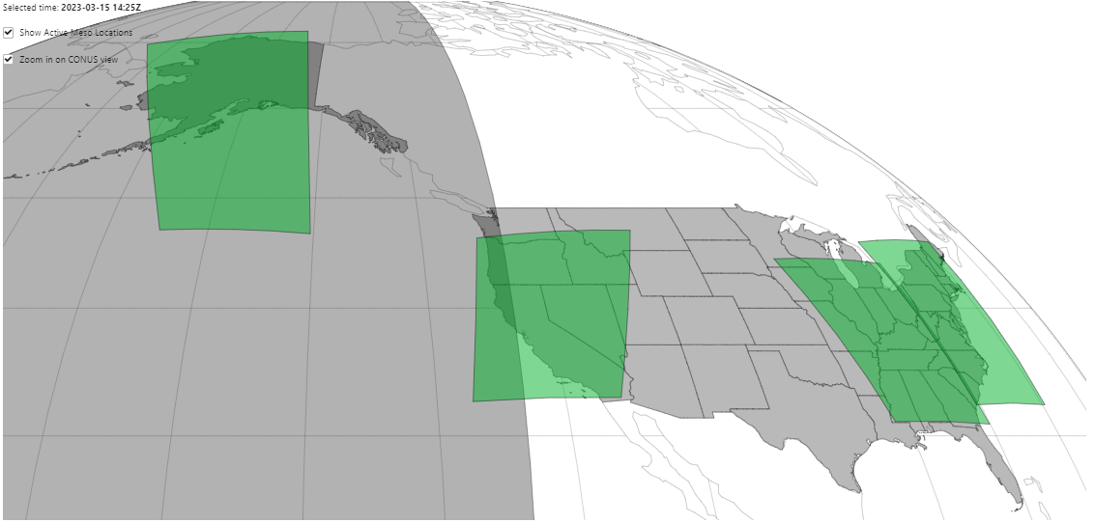

GOES-17 ABI Domains for Standby Operations
If GOES-16 (East) anomaly, then GOES-17 to use default GOES-16 MDS locations
If GOES-18 (West) anomaly, then GOES-17 to use Pacific default MDS location and a new TBD Alaska MDS location
Current GOES-17 CONUS is yellow box. Discussing addition of another CONUS.
Current
Proposed Addition
For GOES-West Role
Domain shapes from Standby will be different from those shown in green.

Slide 4
GOES-18 L1b Science Product Validation Status
ABI L1b Product | Beta | Provisional | Full
Radiances | 5/11/2022 | 7/28/2022 | FY23 Q4
GLM L2 Product
Lightning: Events, Groups, Flashes | 9/16/2022 | 10/31/2022 | FY24 Q1
SEISS L1b Products
Energetic Heavy Ions | 8/1/2022 | 11/15/2022 | FY24
Magnetospheric e⁻/p⁺: Low Energy | 8/1/2022 | 11/29/2022 | FY24
Magnetospheric e⁻/p⁺: High Energy | 8/1/2022 | 10/11/2022 | FY24
Solar & Galactic Protons | 8/1/2022 | 9/13/2022 | FY24
EXIS L1b Products
Solar Flux: EUV | 7/18/2022 | 11/17/2022 | FY24
Solar Flux: X-ray Irradiance | 7/18/2022 | 11/17/2022 | FY24
SUVI L1b Product
Solar EUV Imagery | 8/1/2022 | 11/22/2022 | FY24
GMAG L1b Product
Geomagnetic Field | 7/11/2022 | 9/16/2022 | FY24
Ver: 2/22/23 E. Kline

Slide 5
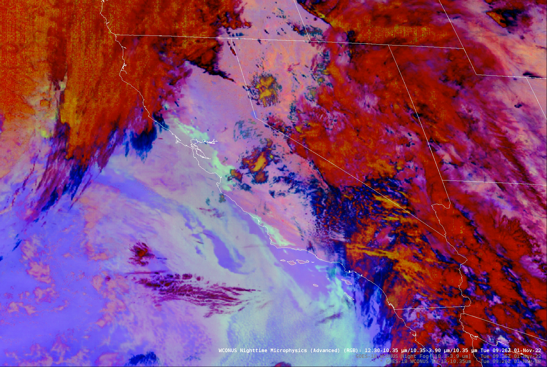
G18 ABI Band 7 Barcode Artifact
An updated version of the pptx on OSPO’s GOES-18 T2O site
is now posted.
NWS reports the artifact has minimal impact and no impact to feature detection.
https://www.ospo.noaa.gov/Operations/GOES/transition.html
Ver: 2/22/23 E. Kline

Slide 6
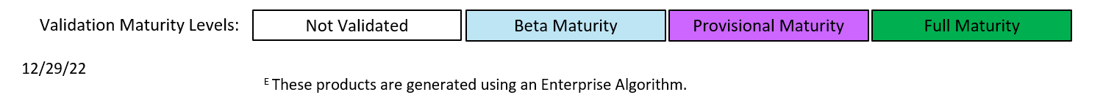
GOES-18 L2+ Science Product Validation Status
L2+ Products | Beta | Prov | Full |  | L2+ Products | Beta | Prov | Full
Cloud and Moisture Imagery (CMI) and Sectorized CMI (KPP) | 5/11/2022 | 7/28/2022 | FY23 |  | Fire/Hot Spot Characterization | 5/11/2022 | 10/12/2022 | FY23
Aerosol Detection (Smoke & Dust) | 5/11/2022 | 11/9/2022 |  |  | Ice Age & Thickness | 5/11/2022 | 12/29/2022
Aerosol Optical Depth | 5/11/2022 | 11/9/2022 |  |  | Ice Concentration & Extent ^{E} | 5/11/2022 | 12/29/2022
Clear Sky Mask ^{E} | 5/11/2022 | 9/28/2022 |  |  | Ice Motion | N/A | 4/20/2023
Cloud Cover Layers | 5/11/2022 | 4/20/2023 |  |  | Land Surface Albedo ^{E} | 5/11/2022 | 11/9/2022
Cloud Optical Depth | 5/11/2022 | 11/21/2022 |  |  | Land Surface Reflectance ^{E} | 5/11/2022 | 11/9/2022
Cloud Particle Size Distribution | 5/11/2022 | 11/21/2022 |  |  | Land Surface Temperature ^{E} | 5/11/2022 | 11/9/2022
Cloud Top Height | 5/11/2022 | 9/28/2022 |  |  | Legacy Vertical Moisture Profile | 5/11/2022 | 10/12/2022
Cloud Top Phase ^{E} | 5/11/2022 | 9/28/2022 |  |  | Legacy Vertical Temperature Profile | 5/11/2022 | 10/12/2022
Cloud Top Pressure | 5/11/2022 | 9/28/2022 |  |  | Rainfall Rate/QPE | 5/11/2022 | 11/9/2022
Cloud Top Temperature | 5/11/2022 | 9/28/2022 |  |  | Reflected S/W Radiation: TOA | 5/11/2022 | 11/9/2022
Derived Motion Winds | 5/11/2022 | 9/28/2022 |  |  | Sea Surface Temperature | 5/11/2022 | 11/21/2022
Derived Stability Indices | 5/11/2022 | 9/12/2022 |  |  | Snow Cover | N/A | 12/9/2022
Downward S/W Radiation: Surface | 5/11/2022 | 11/9/2022 |  |  | Total Precipitable Water | 5/11/2022 | 10/12/2022
Note: Portfolio is incrementally transitioning to Enterprise Algorithms. Updates are sent via ESPC notifications.
noaasis.noaa.gov
Ver: 2/22/23 E. Kline

Slide 7
Remaining GOES-16/17/18 L2+ Enterprise Algorithms
ABI L2+ Products | Distribution to PDA
Ice Motion *^ (Y. Liu, AWG) | 4/17/2023
Rainfall Rate/QPE* (B. Kuligowski, AWG) | 4/17/2023
Aerosol Detection (Smoke & Dust)* (S. Kondragunta, AWG) | 4/17/2023
Aerosol Optical Depth* (I. Laszlo, AWG) | 4/17/2023
Aerosol Particle Size*^ (I. Laszlo, AWG) | 4/17/2023
Downward & Reflected S/W Radiation* (I. Laszlo, AWG) | G16 - 4/26/2023 G18 - 5/4/2023
Derived Motion Winds * (J. Daniels, AWG) | TBD
In order to support Winds, Enterprise Cloud Height must be run in a special mode incompatible with other ABI L2 algorithms. There will need to either be a change to Enterprise Cloud Height or Winds. Additional software delivery will be required.
Legend: * Enterprise Algorithm with GOES-17 LHP mitigation ^ NOAT Funded Algorithm # New Product to PDA
% Enterprise Algorithm without LHP mitigation & Enables Provisional
noaasis.noaa.gov
Ver: 2/22/23 T. Feroli

Slide 8
DO.11 Staggered Release & Reversion
Today
There have been some impacts – primarily in the form of users not fully comprehending and acting on NWS SCN’s about SBN product sector changes. GOES-R remains committed to avoiding future occurrences of staggered releases and reversions. Recall this situation is the realization of known risk associated with the schedule collision of GOES-18 split PLT, interleave, and server replacement which has and continues to result in ground segment lane congestion & closures.
GOES-16/18
  Staggered Release is complete (red line cutovers are synchronized)
  Early upgrades may be induced in the event of failover from WCDAS to CBU for ~April-May
R. Williams

Slide 9



Science Products Training – Recent & Future Events
AMS Joint Satellite Short Course: "Making Beautiful Images of NOAA Satellite Data using Python (hybrid)“ Sunday, January 8, 2023 before AMS 2023 Annual Meeting, Denver CO
  Largest short course audience at AMS
  (34 in person and 35 online)
NOAA/WMO RA IV Virtual Satellite Applications Workshop, (Spanish) El Salvador partners Ministerio de Medio Ambiente y Recursos Naturales (Ministry Of The Environment And Natural Resources) (MARN) March 27-30, 2023
  Registration open
2023 SatMOC Virtual Summer Series for students/early career
  June 20: Career Pathways in the environmental satellite enterprise
  June 22: Cryosphere monitoring
  June 27: Monitoring lake induced phenomena
  June 29: Drought and vegetative health monitoring
”I really appreciated the quality instruction, organized code, pre-course prep instructions, and the positive environment you created at the event.”
October 2023
Ver: 02/23/23 S. Morris
Notes:
Sessions are fully interactive and include homework assignments and classroom reviews.

Slide 10
matthew.seybold@noaa.gov elizabeth.kline@noaa.gov thomas.feroli@noaa.gov ryan.williams@noaa.gov stephen.superczynski@noaa.gov

Slide 11
Backup Slides

Slide 12
GOES-18 CALINR CDRL LUT Status
Instrument | Flight Baseline | Ground Baseline | Update Plan
ABI | CDRL-79 Rev L 2/14/23 | CDRL-79 Rev J 12/22/22 | Rev J: VNIR cal tuning: Q-coefficient updates for Bands 1 and 2 to reduce minor striping seen on bright scenes; k-coefficient update; B02 bias from CWG incorporated. Rev J: RDP LUT updates
GLM | CDRL-79 Rev F 10/21/22 | CDRL-79 Rev F 11/01/22
SUVI | CDRL-79 Rev B 07/22/22 | CDRL-79 Rev B 07/29/22
SEISS | CDRL-88: EHIS v1.1 11/01/22 MPS-HI v1.0 02/14/22 MPS-LO v1.2 05/05/22 SGPS v1.3 02/14/22 | CDRL-88 plus NCEI: EHIS v1.1 11/10/22 MPS-HI NCEI 09/01/22 MPS-LO NCEI 11/01/22 SGPS v1.3 04/01/22 | NCEI MPS-HI LUT delivered 06/27/22 NCEI MPS-LO LUT delivered 09/21/22
EXIS | CDRL-79 Rev D 12/01/22 | CDRL-79 Rev D 12/14/22
GMAG | MAGN03 Rev C 10/05/22 | MAGN03 Rev C 11/01/22
Purpose here is to show status of LUTs and the deliveries that are underway/planned in order to achieve consistency between Flight and Ground. Some vendors plan to submit LUTs post-launch and there is precedent for achieving product maturity with post-launch LUTs.
Ver: 2/13/23 E. Kline
Notes:
PR.09.08.38 contains GLM CDRL79 Rev F, SEISS MPS-LO (NCEI update), and GMAG MAGN03 Rev C. Last LUT delivered 10/21/22, with OE install expected by the end of October. The last major G18 PLT-derived LUT is for SEISS EHIS to be delivered 11/01/22 and will have to be installed with a coordinated Flight Software setting change.

Slide 13
GOES-18 CALINR LUT Update Schedule
PRO Release Number | Delivery Date | Promotion Date | Actual/Planned Content (GOES-18 unless noted)
PR.09.08.38 | 10/21/22 | 11/01/22 | MAG rev C (arcjet correction) SEISS MPS-Lo (NCEI) GLM CDRL79 rev F
PR.09.08.39 | 11/07/22 | 11/10/22 | SEISS EHIS CDRL79
PR.11.02.01 | 12/08/22 | 12/14/22 | ABI CDRL79 rev H (RDP update) EXIS CDRL79 rev D
PR.11.02.02 | 12/21/22 | 12/22/22 | ABI CDRL79 rev J (RDP update)
PR.11.04.01 | 01/19/23 | 02/09/23 | EXIS CDRL79 rev Q (G16) ABI and GLM updates for storage slot (G17)
PR.11.04.02 | 2/10/23 | 02/15/23 | EXIS CDRL79 rev O (G17)
PR.11.04.03 | 2/2/23 | TBD | ABI VNIR k-coefficient update ABI B1&2 Q-coefficient update
PR.11.04.04 | TBD | TBD | G16 & G18 MPS-LO update (from NCEI)
Tremendous amount of work with these installs. Remaining updates non-critical for T2O.
Ver: 2/13/23 E. Kline
Notes:
PR.09.08.38 contains GLM CDRL79 Rev F, SEISS MPS-LO (NCEI update), and GMAG MAGN03 Rev C. Last LUT delivered 10/21/22, with OE install expected by the end of October. The last major G18 PLT-derived LUT is for SEISS EHIS to be delivered 11/01/22 and will have to be installed with a coordinated Flight Software setting change.

Slide 14
Why a Staggered Release & Reversion?
The staggered release and roll-back are the realization of known and tolerable risk associated with the schedule collision of split PLT, interleave, and server replacement which results in ground segment lane congestion & closures
The rollout of DO.11 happens concurrently with ground segment server replacement activities
  The server replacement schedule has been set in large part to accommodate GOES-18 split PLT and operational interleave
The server replacement schedule introduces build/site discontinuities, which the DO.11 rollout rides upon
Four WRs in DO.11, including 5 AWIPS imagery sector updates, are rolled back for the end of January and the month of February
Why not wait until after the server replacement?
  The end of the ground segment’s L3Harris contract is nearing and proceeding allows a greater number of updates to be implemented. Avoiding the rollback would necessitate an additional DO.11 patch and loss of DO.12 content (e.g., fewer fixes overall).

Slide 15
DO.11.02.00 Science Content
WR | Description | Comments | Mitigation
8478 | Add GLM Flash Extent Density product | GLM FED product will not be available during rollback period. | GLM FED distribution over AWIPS will be disabled in DO.11 until the rollback period ends, but will be available via LZSSc.
8299 | Adjust SCMI coverage parameters for NWS - ADR 1138 | Rollback will impact SCMI sector definitions and content. | GOES-R / NWS coordinated mitigation needed.
7579 | Add Helium data to SGPS Product - ADR 1025 - Fix fail | Rollback will cause DQFs to return to "bad data" state | Recommend maintaining current NCEI workaround (ignoring DQFs) until March 2023.
6867 | SUVI GRB radiances have incorrect JPEG 2000 sgnd (signed) flag | Rollback has minimal impact to GRB only. | None needed. CSPP Geo technical staff confirms that their current workaround (ignoring the flag) is forward compatible with the DO.11 correction.
Details for WR 8299
Truncate the Full Disk (FD) sector, populating only the Northern Hemisphere (NH) portion. No changes are requested in Product Region Indicators or Data Short Names, which are to remain as FD names. The total number of tiles per band will be half of their previous value.
Change band 13 (IR Window) in the NH sector to full (2 km) resolution.
Remove the current "Hawaii Regional" sector, all bands (1-16)
Add a new American Samoa sector, full (2 km) resolution band 13 only. Coverage region is approximately 5S - 25S, 170E(190W) - 160W.
Remove bands 11, 12, 14 and 16 from the "Puerto Rico" sector.

Slide 16
DO.12.00.00 Science Content
ADR | WR# | Algorithm | Headline | Summary | GRB Impact | PUG Impact
780 | 6845 | SEISS MPS-Hi, SEISS MPS-LO | GPA update for SEISS MPS-HI and MPS-LO L1b IFC leakage | IFC pulses are leaking into L1b fluxes. This fix resolves the data gaps.
 | 7449 | GLM | GLM Geographic Coverage Extents are incorrect | The lat_field_of_view_bounds and lon_field_of_view_bounds had small errors and are now fixed. |  | x
1105 | 7945 | ABI. CMI | Incorrect planck_fk1 metadata in L1b, CMIP and PUG | Fixes planck_fk1 units and long name in metadata |  | x
1130 | 8263 | EXIS XRS | XRS SPP_roll_angle variable | Fixes SPP_to_Sun_roll_angle long name and comment attributes
894, 1087 | 8323 | EUVS | EUVS line irradiances and ratios during bad pointing and low SPS signal | Fixes the way quality flags behave during certain situations.
781 | 8404 | SEISS MPS-Hi, SEISS SGPS | MPS-HI and SGPS L1b data gaps near IFCs part 2 | Resolves issues of data gaps near IFCs.
1147 | 8433 | SUVI | SUVI LUT needs to accommodate more flat fields | This makes SUVI flat fields more configurable.
1158 | 8763 | EXIS EUVS | Create EUVS calibration flags | Creates new EUVS calibration flags. |  | x
1144 | 8764 | EXIS EUVS, EXIS XRS | EXIS during eclipse or lunar transit | Fixes calibration flags during certain data gaps. |  | x
1181 | 8787 | SUVI | SUVI J2000 time incorrect in netCDF files | Fixes error in metadata definitions of epoch time. |  | x
1194 | 8840 | ABI L1b | GSICS Correction in ABI L1b | Adds GSICS correction values to ABI L1b. |  | x
1159 | 8932 | SUVI | SUVI SAT_THR not calculated correctly | Returns SAT_THR to be the maximum theoretical recordable radiance.
1203 | 8970 | MAG, GMAG | Mag L1b solar array current index label incorrect | Fixes telemetry mnemonics that correspond to the solar array current.
 | 9203 | ABI SCMI | Enable SCMI netCDF Shuffle to reduce file sizes | Reduces files size of SCMI.
1171 | 9326 | EXIS, MAG, GMAG, SEISS | EXIS/MAG/SEISS ECEF_Z range | Fixes the ECEF_Z value to +/-1.72e7 |  | x

Slide 17
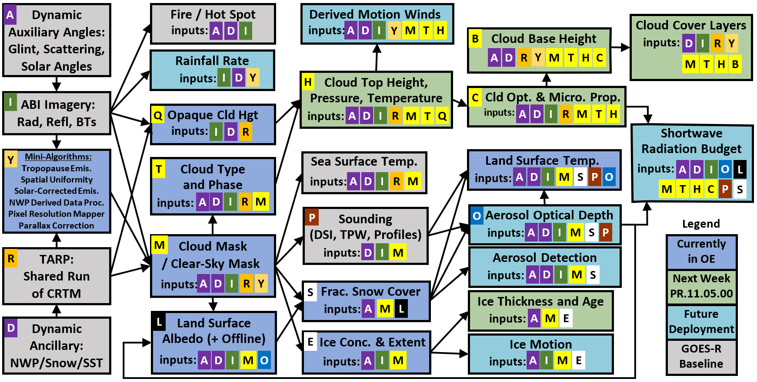
ABI L2+ Algorithm Precedence
T. Feroli, C. Burnett

